Slide 1
Text Mining
CME4416 – Introduction to Data Mining

Slide 2

Outline
What is Text Mining?
Goals of Text Mining
Text Mining vs Data Mining
Text Mining Process (6 Steps)
Text Mining Applications
Text Mining Operations

Slide 3
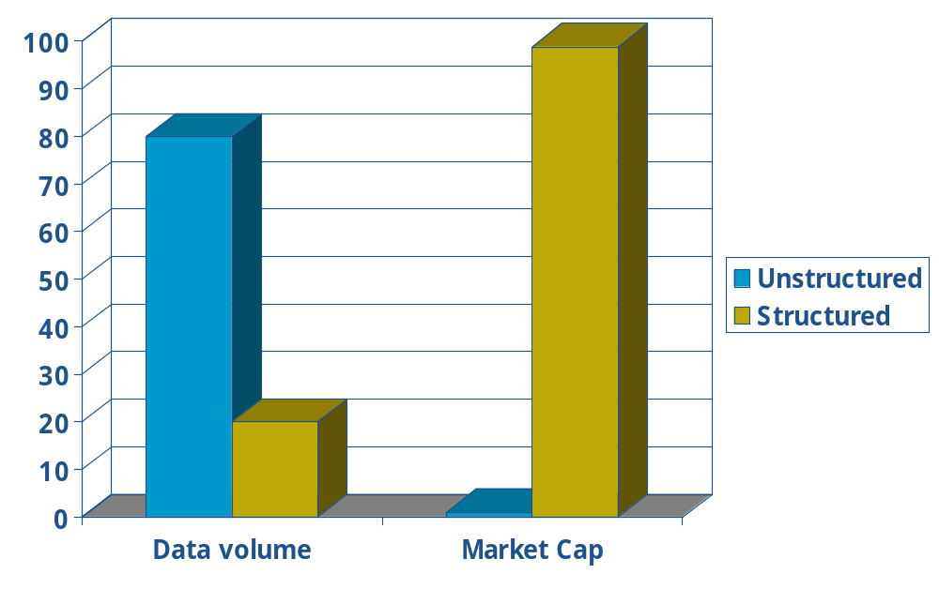

Introduction
Information explosive
80% information stored in text
Documents, Journals, Reports, Web Pages, E-mails...
Difficult to extract special information
It is necessary to automatically analyze, organize, summarize...

Slide 4





Text Resources
?
?
E-books
Scientific Articles
News Articles
Technical Documents
Web Pages
Email
Contracts
Patent Portfolios
Customer Complaint Letters
Transcripts of Phone Calls with Customers
...
Internet

Slide 5



What is Text Mining?
Text Mining is the process of analyzing the relations, the patterns, and the rules among textual data (semi-structured or unstructured text)
Text Mining is the discovery by computer of new, previously unknown information, by automatically extracting information from different written resources.
Text Mining
Text Mining
Knowledge

Slide 6
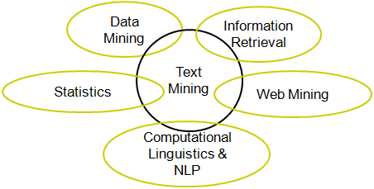
Text Mining Research Communities
Text mining research – integrate research from several research communities such as:
  Database (DB)
  Information Retrieval (IR)
  Information Extraction (IE)
  Statistics
  Natural Language Processing
  ...

Slide 7
Text Mining Examples
Information that not even the writer knows.
  e.g., Discovering a new method for a hair growth that is described as a side effect for a different procedure
Rediscover the information that the author encoded in the text
  e.g., Automatically extracting a product’s name from a web-page.

Slide 8

Goals of Text Mining
Goals:
  Minimize the amount of text we must read.
  Isolate pieces of information, such as the name of person and the person’s role in the company.
  Discover relationships between terms
  Discover valid, useful, and previously unknown knowledge

Slide 9
Data Mining vs. Text Mining
Data Mining Text Mining
Data Object Numerical & categorical data Textual data
Data structure Structure Unstructure & Semi-Structure
Data representation Straightforward Complex
Space dimension < tens of thousands > tens of thousands
Methods Data analysis, machine learning, Information retrieval, NLP,...
statistic, neural networks
Maturity Broad implementation since1994 Broad implementation starting
2000
Market Large and mid size companies Corporate workers and
individual users

Slide 10
“Search” versus “Discover”
Search
(goal-oriented)
Discover
(opportunistic)
Structured
Data
Data
Retrieval
Data
Mining
Unstructured
Data (Text)
Information
Retrieval
Text
Mining

Slide 11
Unstructured Text
Morphology - Structure of words
  Prefix - word stem - suffix, inflected word forms (e.g. manag- e/es/ing/ed)
Syntax - Combination of word to form phrases (sözcük grupları)
  Noun and verb groubs, subject – predicate – object
Semantics - Meaning of words and phrases
  Synomyms: Different words, but same meaning
  Homonyms: Same word, but different meanings

Slide 12
Text Mining Difficulty
Large textual data base
  over 2,000,000,000 web pages
High dimensionality
  Consider each word/phrase as a dimension
Ambiguity
  Word ambiguity
    Pronouns (he, she …)
    “buy”, “purchase”
  Semantic ambiguity
    The king saw the rabbit with his glasses. (8 meanings)
Noisy data
    Example: Spelling mistakes
Not well structured text
  Chat rooms
    “r u available ?”
    “Hey whazzzzzz up”

Slide 13
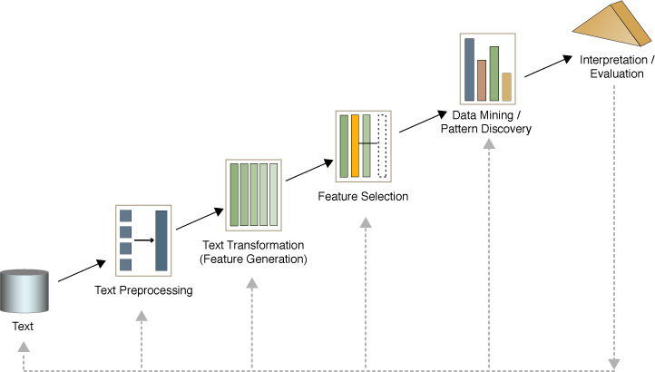
Text Mining Process (6 Steps)
Collect relevant documents
  Identify source and documents
  Retrieve them from Web or from internal file systems
Pre-processing documents
  Syntactic/Semantic text analysis
Features Generation
  Text document is represented by the words it contains (e.g., “Lord of the rings” → {“the”, “Lord”, “rings”, “of”})
  Identifies a word by its root (e.g., flying, flew → fly)
  Stop words: The most common words are unlikely to help text mining
  e.g., “the”, “a”, “an”, “you” …
Features Selection
  Reduce dimensionality - Irrelevant features
  e.g., the existence of a noun in a news
  article is unlikely to help classify it as “politics” or “sport”
Text mining operations
  Patterns and relationships are discovered.
  e.g., classification, clustering
Evaluation of text mining results

Slide 14
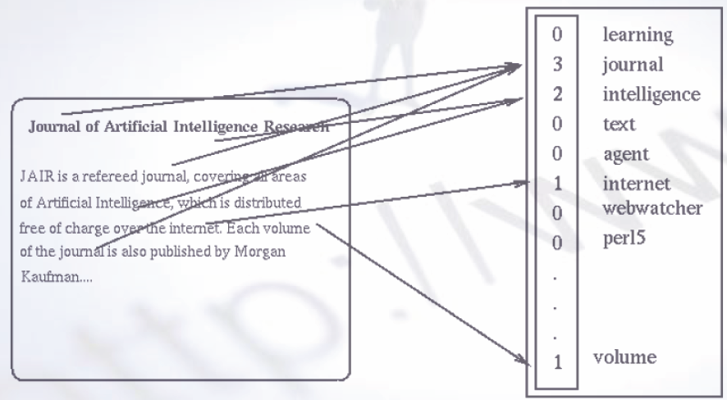
Feature Generation Example

Slide 15
Feature Generation Example
Hi,
Here is your weekly update (that unfortunately hasn't gone out in about a month). Not much action here right now.
1) Due to the unwavering insistence of a member of the group, the ncsa.d2k.modules.core.datatype package is now completely independent of the d2k application.
2) Transformations are now handled differently in Tables. Previously, transformations were done using a TransformationModule. That module could then be added to a list that an ExampleTable kept. Now, there is an interface called Transformation and a sub-interface called ReversibleTransformation.
hi, weekly update (that unfortunately gone out month). much action here right now. 1) due unwavering insistence member group, ncsa.d2k.modules.core.datatype package now completely independent d2k application. 2) transformations now handled differently tables. previously, transformations done using transformationmodule. module added list exampletable kept. now, interface called transformation sub-interface called reversibletransformation.
hi week update unfortunate go out month much action here right now 1 due unwaver insistence member group ncsa d2k modules core datatype package now complete independence d2k application 2 transformation now handle different table previous transformation do use transformationmodule module add list exampletable keep now interface call transformation sub-interface call reversibletransformation

Slide 16
Feature Selection Example
hi week update unfortunate go out month much action here right now 1 due unwaver insistence member group ncsa d2k modules core datatype package now complete independence d2k application 2 transformation now handle different table previous transformation do use transformationmodule module add list exampletable keep now interface call transformation sub-interface call reversibletransformation
hi
week
update
unfortunate
go
out
month
much
action
here
right
now
1
due
unwaver
insistence
member
group
ncsa
d2k
modules
do
core
datatype
package
complete
independence
application
2
transformation
handle
different
table
previous
use
transformationmodule
add
list
exampletable
keep
interface
call
sub-interface
reversibletransformation
hi
week
update
unfortunate
go
out
month
much
action
here
right
now
due
insistence
member
group
modules
do
core
datatype
package
complete
independence
application
transformation
handle
different
table
previous
use
add
list
keep
interface
call
sub-interface

Slide 17
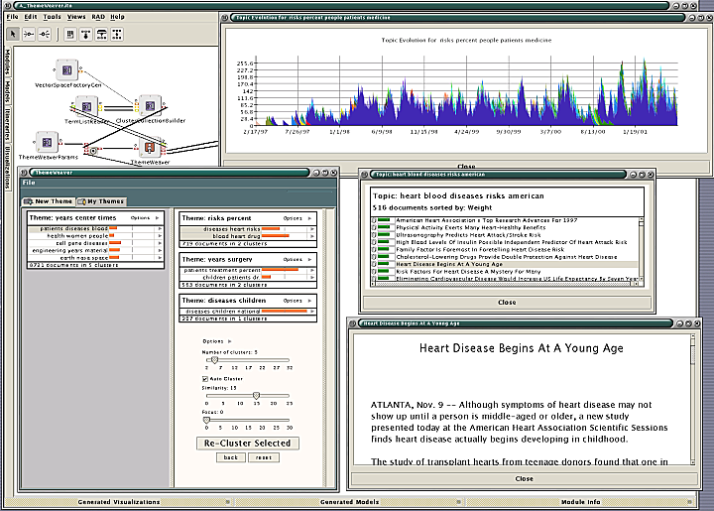
Text Mining Applications
Email: Spam filtering
Marketing: Discover distinct groups of potential buyers according to a user text based profile
  e.g. amazon
Industry: Identifying groups of competitors web pages
  e.g., competing products and their prices
Job seeking: Identify parameters in searching for jobs
  e.g., www.flipdog.com

Slide 18

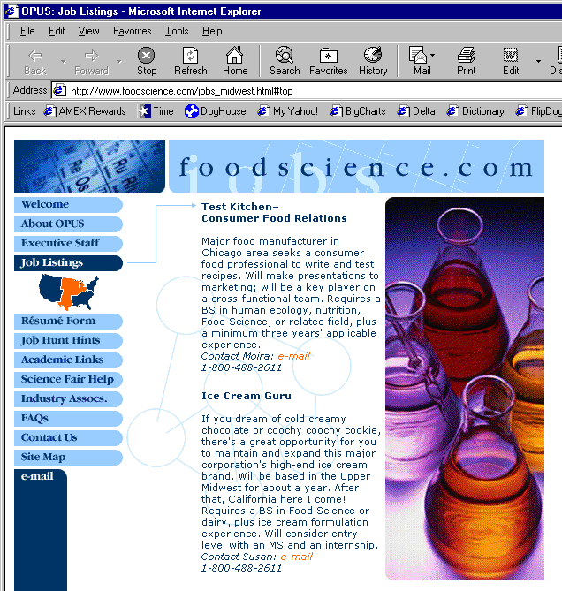
Example – Job Information Extraction
foodscience.com-Job2
JobTitle: Ice Cream Guru
Employer: foodscience.com
JobCategory: Travel/Hospitality
JobFunction: Food Services
JobLocation: Upper Midwest
Contact Phone: 800-488-2611
DateExtracted: January 8, 2001
Source: www.foodscience.com/jobs_midwest.html
OtherCompanyJobs: foodscience.com-Job1
Notes:
WB’s first application area is extracting job openings from the web.
Start at company home page, automatically follow links to find the job openings section, segment job openings from each other, and extract job title, location, description, and all of these fields.
(Notice that capitalization, position on page, bold face are just as much indicators of this being a job title as the words themselves.
Notice also that part of the IE task is figuring out which links to follow.)

Slide 19
Text Mining Operations
Text Clustering (Document Clustering)
Text Classification (Document Categorization)
Summarization
Associations (e.g. occurrence of A together with B )
Question Answering

Slide 20
Text Mining Operations
1-Clustering
Given:
  Set of documents and a similarity measure among documents
Similarity measure:
  Problem-specific measures
  e.g., how many words are common in these documents
Find:
  Clustering of related documents
    Documents in one cluster are more similar to one another
    Documents in separate clusters are less similar to one another
Methods:
  Partitioning Methods
  Hierarchical Methods
Documents
source
Similarity measure
Clustering
System
Doc
Doc
Doc
Doc
Doc
Doc
Doc
Doc
Doc
Doc

Slide 21
Text Mining Operations
2-Classification
Given: Collection of labeled records
  Each record contains a set of features (attributes), and the true class (label)
  Create a training set to build the model
  Create a testing set to test the model
Find: Model for the class as a function of the values of the features
Goal: Assign a class to previously unseen records
Classification Techniques
  Decision trees
  Neural networks
  Bayesian classification

Slide 22
Text Mining Operations
2-Classification
Categorization of Documents
Model Construction Model Usage
New Documents:
Training Archive:
1. Training
a decision tree
2. Applying the
decision tree
Test Archive:
Classified
Dokuments:
Example: Annotation of the training archive with n types of events
Example: Tagging new documents with one of n known events

Slide 23
Text Mining Operations
2-Classification - Document Categorization
BOISE, Idaho (CNN) -- Cooler weather Monday in the U.S. Pacific Northwest may help more than 27,000 firefighters in their marathon battle against dozens of wildfires. Ten new large fires were reported overnight into Monday, bringing to 40 the number of large fires ablaze, said officials at the National Interagency Fire Center. They said between 300,000 and 400,000 acres are aflame. The good news is that five large fires were contained Sunday. So far, about 2.8 million acres of forest have burned this year, making 2001 an average year for fires. Center officials said 241 fires were reported Sunday into Monday but 96 percent were contained or extinguished in "initial attacks" by firefighters. A large fire is defined as a fire burning uncontained and extending over 100 acres or more.
Politics
Economic
Social
Enviromental
Cultural
  e.g., classifying “football” document as a “basketball” document is not as bad as classifying it as “crime”.

Slide 24
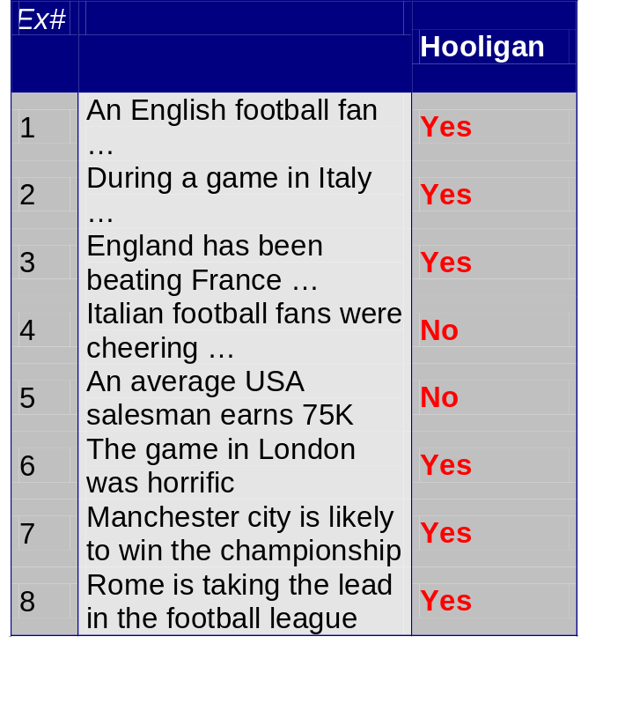
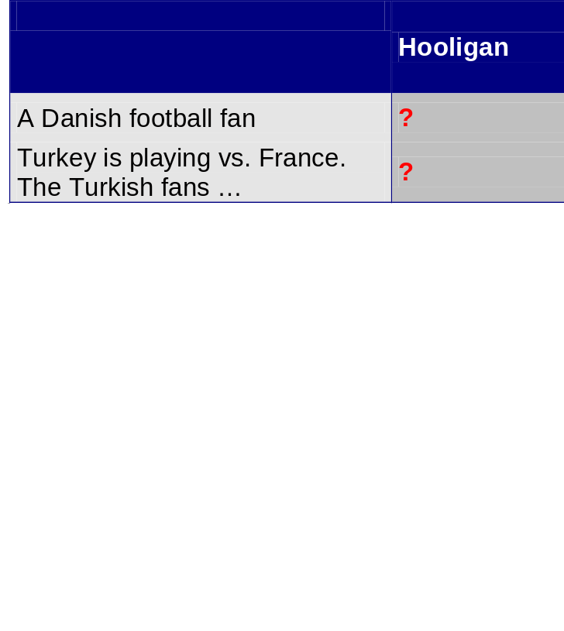
Text Mining Operations
2-Classification – Decision Tree
text
class
Test
Set
Learn
Classifier
Training
Set
Model

Slide 25
Text Mining Operations
2-Classification – Neural Network
Threshold
Hooligan
Weights vector
2.5
-0.9
1.2
Hidden nodes
Weights vector
0.9
3
-0.4
-0.8
0
0.7
1.2
-0.2
1
-2
Input vector
as
ball
cool
pain
Spain
foot
break
FC
soccer
football
Multi-layer

Slide 26
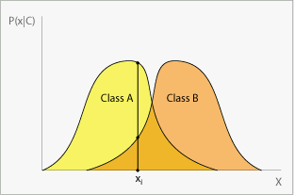
Text Mining Operations
2-Classification – Bayesian Classification
The classification problem may be formalized using probabilities:
P(C|X) = prob. that the example is of class C
e.g. P(Hooligan | English, fan, married…)
Idea: assign to example X the class label C such that P(C|X) is maximal
Bayes theorem: P(C|X) = P(X|C)·P(C) / P(X)

Slide 27
Text Mining Operations
3-Associations
Example:
In a given a food-industry corpus:
“98% of the documents which are interested on apple juice does it related with the chromatography analytic technique”
X ⇒ Y : “apple juice ⇒ chromatography”

Slide 28
Text Mining Operations
4-Summarizing
High-level summary or survey of all main points
Example: sentence extraction from a single document
Method (How to summarize a collection?)
  Start with training set, allows evaluation
  Create heuristics to identify important sentences
  Classification function estimates the probability a given sentence is included in the abstract

Slide 29
Text Mining Operations
5-Question Answering
Goal
  Use Encyclopaedia / other source to answer “Trivial Pursuit-style” factoid questions
Example
  “Where is Mount Everest?”
Method:
  Heuristics about question type: who, when, where
  Match up noun phrases within and across documents
https://www.evi.com/

Slide 30
Acknowledgement
Asst. Prof. Dr. Derya BİRANT

